Slide 1
Data-backed solutions for combating wnv in chicago
Machine-Learning Approach
to minimise cost and
maximise benefit
Presented by Data Nine-Nine

Slide 2
Breaking Down the Numbers
25,769
2,773
Hospitalized
death
Number of Hospitalization cases from 1999 to 2022
Number of Death cases from 1999 to 2022
Source: https://www.cdc.gov/westnile/statsmaps/historic-data.html

Slide 3
SYMPTOMS OF west nile virus
Swollen lymph gland, Stiff neck
Headache, disorientation
Muscle pain,
rash
Nausea
Source: https://www.vdci.net/

Slide 4
West nile virus
20%
2%
10%
100%
1 in 5 develop symptoms
1 in 50
Age > 60 developed severe illness
1 in 10 with severe illness die.
100% possible to reduce the risk with preventive actions!
Source: https://www.cdc.gov/westnile/index.html

Slide 5

Prevention is key!

Slide 6
Methodologies
Data
Cleaning
Cost-Benefit Analysis
Modelling
Step 1
Step 3
step 5
Problem Statement
Step 2
Exploratory Data Analysis
step 4
Model Evaluation
step 6

Slide 7
Problem statement
01
You could enter a subtitle here if you need it

Slide 8
Problem STatement
Build Machine Learning model to predict the presence of WNV
Provide valuable insights and recommendations to further enhance their strategies.
We, Data Nine-Nine, have been engaged as a third-party consulting firm by the Centre for Disease Control and Prevention (CDC) to collaborate on a comprehensive review of their West Nile Virus (WNV) control efforts.
Our objective is to:

Slide 9
Data cleaning
02
Data Preparation prior to analysis and modeling

Slide 10
Datasets
 | 2007 | 2008 | 2009 | 2010 | 2011 | 2012 | 2013 | 2014
train_df | May - Oct |  | May - Oct |  | Jun - Sep |  | Jun - Sep
test_df |  | Jun - Sep |  | Jun - Oct |  | Jun - Sep |  | Jun - Oct
weather_df | May - Oct | May - Oct | May - Oct | May - Oct | May - Oct | May - Oct | May - Oct | May - Oct
spray_df |  |  |  |  | Aug - Sep |  | Jul - Sep

Slide 11
Data Cleaning
10,506
8,610
Rows before
Rows after
number of mosquitos capped at 50 per row
groupby to sum total number of mosquitoes

Slide 12
Aggregate mosquitoes data from
Train_df
135,039
2,206
7
Total number of mosquitoes caught over 4 years.
Highest number of mosquitoes caught in a day.
Species of mosquitoes caught

Slide 13
Feature Engineering
Min/max/avg Temp
Day length
Lagged TEMP/Humidity/rainfall
precipitation
Split by station & average between the 2 station
The number of daylight in hours & minutes derived from sunrise & sunset
Weather data lagged by up to 4 weeks
Split by station & average between the 2 station

Slide 14
Data merging
train_df
weather_df
train_merge
Group by Dates
test_df
weather_df
test_merge

Slide 15
Exploratory data analysis
03
Data Visualisation & Analysis

Slide 16
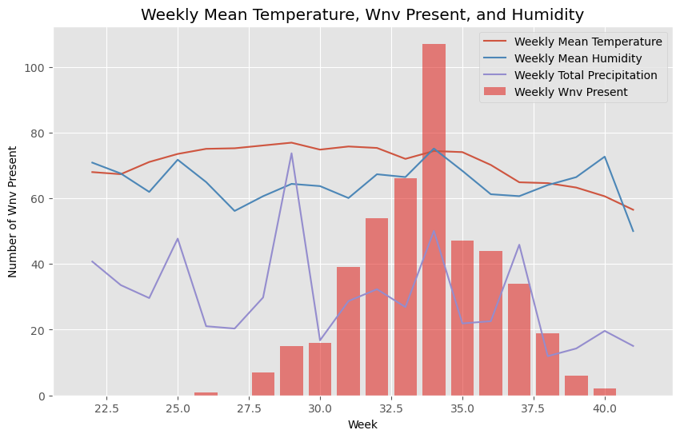
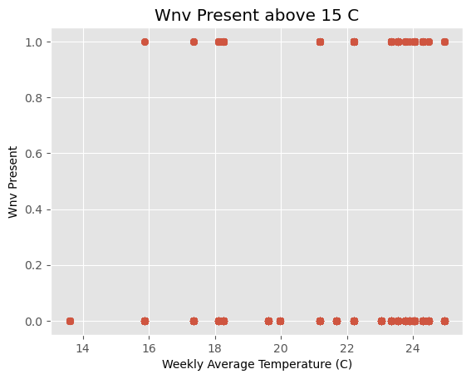
WEATHER CONDITION vs WNV cases
Note: Graph only shows correlation, not causation

Slide 17
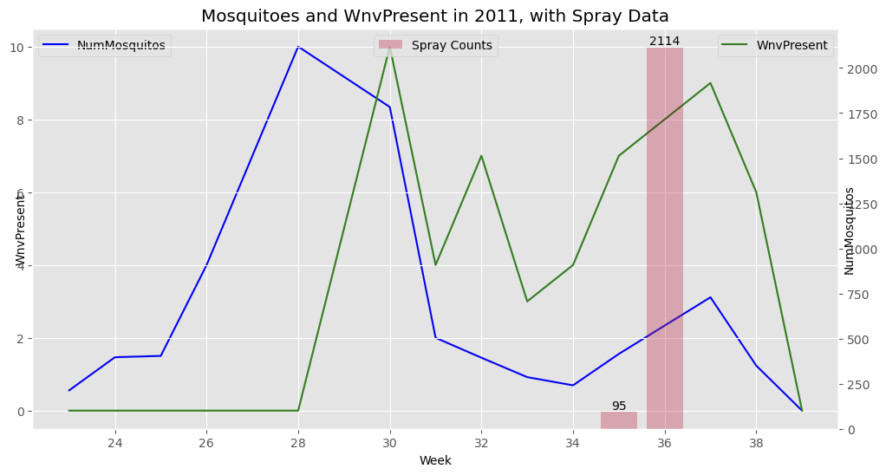
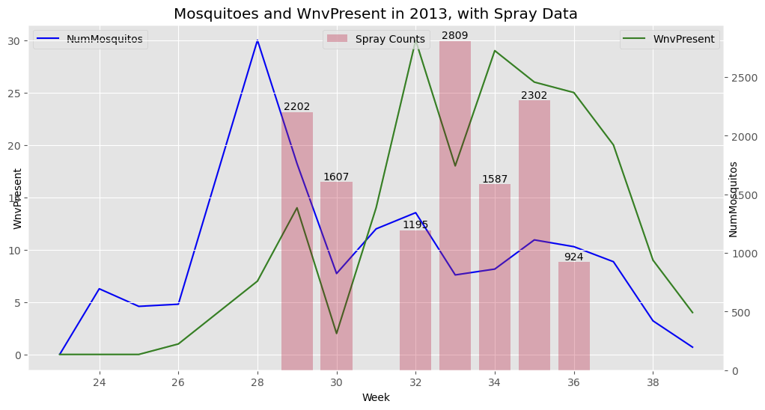
Are Mosquito
SPRAYs
effective?
Red bar
is SPRAY

Slide 18
Modelling
04
Preprocessing & Model Deployment

Slide 19
MODELLING PREPROCESSING
OHE
SMOTE
ss
One Hot Encoder
Transforms Categorical Data Into Numerical
Synthetic Minority Oversampling Technique
Balance the Target Class to a 50:50 ratio
Standard Scaler
Transform all features into similar Scale & Distribution.
Notes:
3 preprocessing steps were carried out prior modeling. These are carried out in series, one after the other.
1st is OHE…
2nd is SMOTE
3rd is the Standard Scaler

Slide 20

ONE HOT ENCODER
3
260+
Dummification
Categorical
data
Numerical
data
[Species, Street, Trap]
7 species
128 streets
136 traps
Notes:
Why One Hot Encode? Machine Learning model can only take in numerical data
So what One Hot Encoder does is it converts the Categorical features into 1s & 0s so the model can read

Slide 21
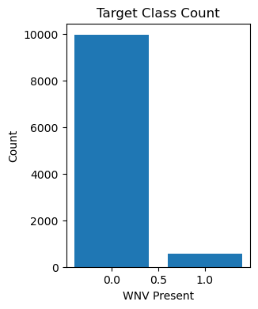
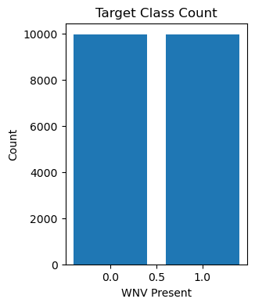
Synthetic Minority oversampling teCHNIQUE (SMOTE)
SMOTE
Imbalance
Notes:
Why SMOTE? Target class is badly imbalance with positive class @ 5% of the whole dataset.
If fed into the model, it might not perform well in identifying the minority class
SMOTE helps address this imbalance by creating synthetic examples of the minority class.
Resample the data by creating new, artificial examples similar to the minority class.
Both classes are equal
Steps:
Identify Minority Class: First, SMOTE identifies the minority class.
Choose Neighbors: SMOTE then looks at each minority class example and selects its neighboring examples. These neighbors can be thought of as similar instances of the minority class.
Create Synthetic Examples: For each minority class example, SMOTE creates synthetic examples by combining features from the chosen neighbors. It randomly selects one of the neighbors, looks at the feature differences between the example and the neighbor, and adds a proportion of those differences to the example. This creates a new synthetic example that lies between the example and its chosen neighbor.
Repeat for Desired Amount: SMOTE repeats this process until it generates the desired amount of synthetic examples for the minority class, thereby balancing the dataset.

Slide 22
Modelling Workflow
Model used Hyperparameters tuning ensemble
Logistic
Regression
400
Fits of LR
Random Forest Classifier
200
Fits of RFC
Voting
Classifier
XGBoost Classifier
1200
Fits of XGB
AdaBoost Classifier
300
Fits of ABC
Notes:
After the preprocessing steps, the data is ready for the model to train on.
We deployed 4 models, namely..
Hyperparameters tuning were carried on all 4 models for evaluation
Lastly the Ensemble Voting Classifier was deployed with 4 previously trained models to make prediction on the dataset

Slide 23
mODEL EVALUATION
05
Model Performance Review

Slide 24
metrics
01
02
SENSITIVITY
SPECIFICITY
03
AUC
Measures the proportion of actual positive cases correctly identified by the model
Measures the proportion of actual negative cases correctly identified by the model
Area Under the ROC Curve (AUC)
measure of how well the classifier can distinguish between the positive and negative classes.

Slide 25
mODEL SCORE
 | TPR¹ | TNR² | Train ROC | Test ROC | Kaggle³
Logistic Regression (Baseline) | 0.7802 | 0.7419 | 0.8670 | 0.8269 | 0.7559
Random Forest Classifier | 0.8352 | 0.7069 | 0.8597 | 0.8552 | 0.7334
XGBoost Classifier | 0.1319 | 0.9853 | 0.9238 | 0.8733 | 0.7837
AdaBoost Classifier | 0.7253 | 0.8124 | 0.8259 | 0.8564 | 0.7680
Voting Classifier | 0.6703 | 0.8443 | 0.8987 | 0.8645 | 0.7846
1 - True Positive Rate or Sensitivity. 2 - True Negative Rate or Specificity. 3 - Public Score (AUC)
AdaBoost Hyperparameters | N Estimator - 300 | Learning Rate - 0.05 | K-neighbour in SMOTE - 3

Slide 26
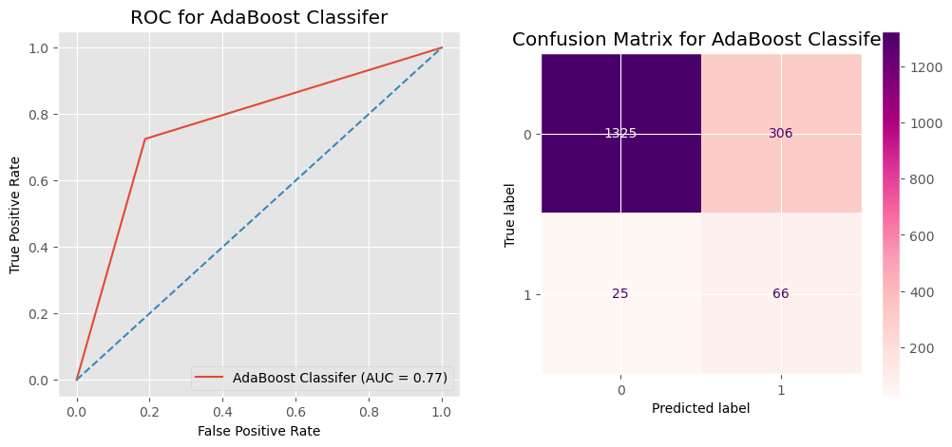
AUC plot & CONFUSION MATRIX
TN
FP
WNV Absent
Actual
FN
TP
WNV Present
WNV Absent
WNV Present
Predicted

Slide 27
Cost-benefit analysis
06
Treatment & Prevention Proposal
Notes:
Thank you WenXi for sharing how we built our model. Now it’s time to have some recap of the key numbers.

Slide 28
FAcTual treatment numbers
From 1999 to 2022
56,569
~45.5%
~50.6%
Reported cases of WNV Disease
Requires hospitalisation
With Neurologic Invasive Disease
Source from CDC : https://www.cdc.gov/westnile/statsmaps/historic-data.html
Notes:
1,999 was the first year where the first West Nile Virus was observed and till date we have had 56,569 reported cases where roughly half of them requires hospitalisation and neurologic invasive diseases.
The 3 numbers are important because the medical treatment cost has a very big range depending on the symptoms observed.

Slide 29
Median Hospitalised Financial costs
 | Initial Costs /Person | Long Term Costs /Person | Total Costs / Person
Fever | $4,617 | $2,271 | $6,888
Meningitis | $7,942 | $10,556 | $18,498
Encephalitis | $20,105 | $8,055 | $28,160
Acute Flaccid Paralysis | $25,117 | $22,628 | $47,745
Sources from National Library of Medicine : https://www.ncbi.nlm.nih.gov/pmc/articles/PMC3945683/
Notes:
We have arranged the medical costs required to from low to high.
The moment a person requires hospitalisation, that is when the medical treatment costs become really high.
Note that these numbers have yet to taken into account of potential income loss due to unable to work.

Slide 30
Cost of controlling measures
Aerial Spray
Sentinel chickens
$1471 / km²
$203 / flock
Mosquitoes Trap
Website maintenance
$200 - $4500 / month
$ 120 - $180 / trap
Aerial Spray
Chickens placed at WNV area to detect WNV
Price data from Hostinger.com
Price data from Amazon
Source from National Library of Medicine : https://www.ncbi.nlm.nih.gov/pmc/articles/PMC3322011/
Notes:
Now we are going to compare the medical costs we had just now with the cost of controlling measures.
We can easily see that relative to the treatment cost, the cost of controlling measures is much lower.
Everything is self explanatory other than sentinel chickens, where we deploy chickens to mosquitoes populated area and actively test their blood samples to detect the presence of west nile virus.

Slide 31
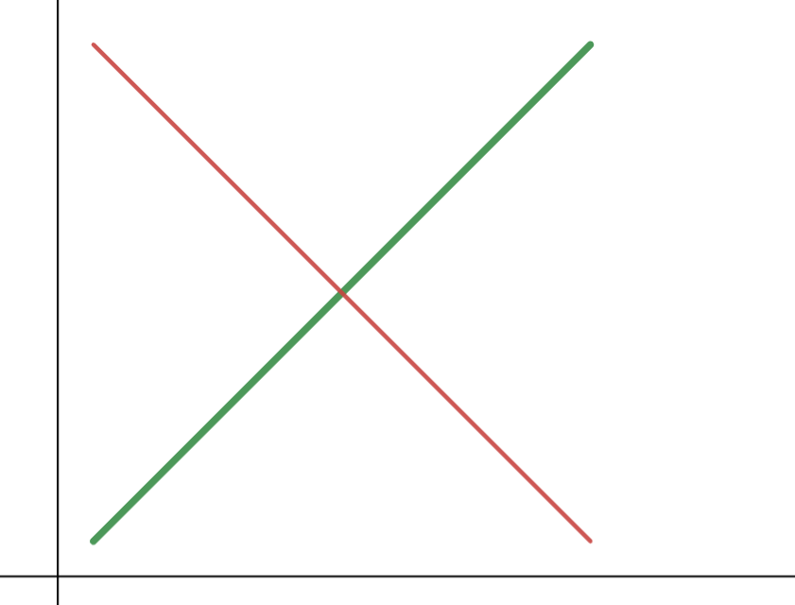
benefit
Economist Metrics
~$56 millions / year
For United States
2.67% population
Chicago / US
~$1.5 millions
At equilibrium
~$1.5 millions / year
For Chicago
cost
Source: https://astmhpressroom.wordpress.com/journal/february-2014/
Notes:
Based on American Society of Tropical Medicine, the overall estimated loss of west nile virus is 56 millions per year.
Given that Chicago City is having 2.67% of US population, we did a simple ratio calculation and came out that
Chicago city loss about 1.5 millions per year for West Nile Virus.

Slide 32
Controlling Measures at a glance
 | Minimalist | Economist | Life-Saving
Protective Measures | Educational Campaign on Website | Machine Learning Social Media Campaign + Prediction for Detection + Spray Decision | Mass Educational Campaign on Social Media
Early Detection |  |  | Sentinel Chicken + Mosquitoes Surveillance
Spread Control | Spray after first Human Case |  | Spray after Early Detection Method
Sources from National Library of Medicine : https://www.ncbi.nlm.nih.gov/pmc/articles/PMC3367363/
Notes:
With reference to that, we have come out with 3 approaches in fighting against west nile virus.
Where minimalist is to start taking actions only after human case.
For economist, we will use machine learning in assisting us to make decisions where the life-saving approach is to deploy on the ground methods in early detection and perform preventive measures for it.

Slide 33
Summary of approaches
 | Minimalist approach | Economist approach | Life-Saving approach
Pros | Easy to implement Cost-saving | Cost-effective approach | Proactive and Diligent approach
Cons | Reactive Measures | Does not cover all grounds | Difficult to implement Expensive
Intent | Minimalising complexity in implementing the measures | Maximising benefit per dollar spent over preventive measures | Maximising potential life saves Minimalising number of mosquitos
Notes:
The pros and cons of each method is listed in the table here.
Every method has its own merits but we have to be aware that we have constraints when it comes to reality.
In our most ideal situation, we’d like to have sufficient effort invested to fight against the virus and at the same time, deploy our resources within constraints and means.

Slide 34
Potential Cost reduction by machine learning
Machine learning
~3.53 millions
~814 thousands
~78.5%
reduction
Source from National Library of Medicine : https://www.ncbi.nlm.nih.gov/pmc/articles/PMC3322011/
Notes:
For example, one of the constraints we have is financial constraints.
If we were to spray diligently according to life-saving approach, with reference to data from other cities, we would easily spend about 3.5 million dollars.
With the help of machine learning, when we spray all positive predictions and area of false negative predictions, we might reduce the cost by 78.5% to 814 thousands.

Slide 35
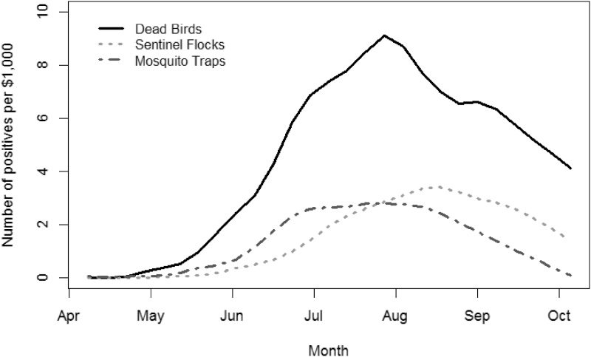
Timeliness of intervention
August
best return per dollar spent
Source from National Library of Medicine : https://www.ncbi.nlm.nih.gov/pmc/articles/PMC3322011/
Notes:
Also, as shared earlier, we want our per dollar spent to be effective, while we don’t have the chart for effectiveness in spraying.
We can derive that spraying in August will have more potential value than spraying in other months.

Slide 36
RECOMMENDATIONs
Time your effort
(2) focus on culex pipiens populated areas
(3) Initiate localised social media campaign
May to October: Economist Approach
November to April: Minimalist Approach
Notes:
So our recommendations is as such.
From May to October, we prevent West Nile Virus by Economist Approach and during down season of West Nile Virus, we go with the minimalist approach.
As mentioned from our EDA, once Culex Pipiens have found to be present in an area, the area deserves 5 times more attention than all other species.

Slide 37
RECOMMENDATIONs
Effectiveness
protective educations > Early detection > intervention > medical
Price to pay
protective educations < Early detection < intervention < medical
Notes:
Protective Educations are the lowest cost with highest potential return. Teaching residents to wear long sleeves on August might prove to be a more successful prevention measures than spraying the whole city.
Our educational campaign is at this point in time, still depending much on the local agencies. We’ll propose to start considering doing educational campaign over social media from May to Sep to

Slide 38
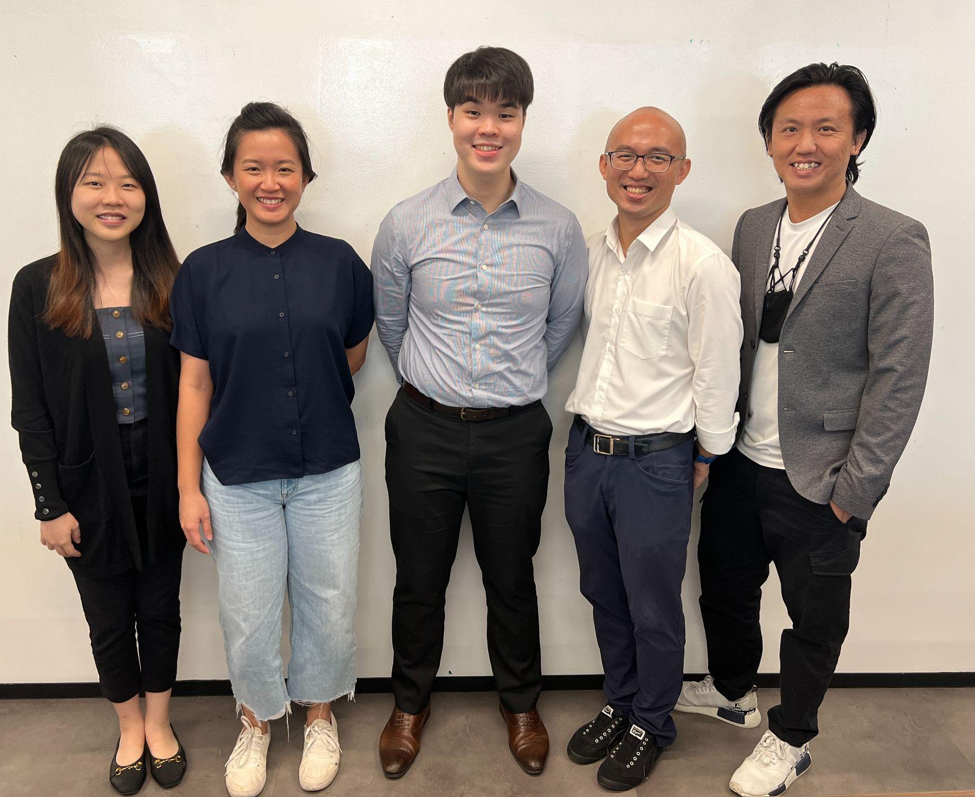
Thank you
And say no to life loss
Data Nine-Nine
Ming Fatt
Jasmine
JJ
Willson
Wenxi

Slide 39
appendix

Slide 40
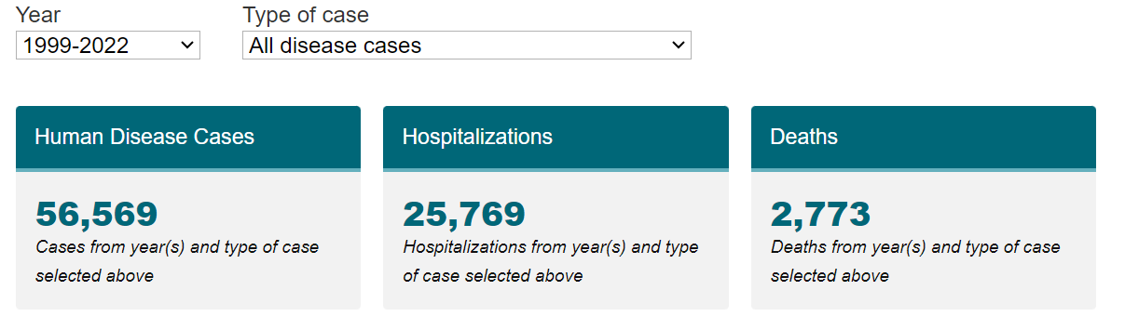
All disease numbers
Source from CDC : https://www.cdc.gov/westnile/statsmaps/historic-data.html

Slide 41
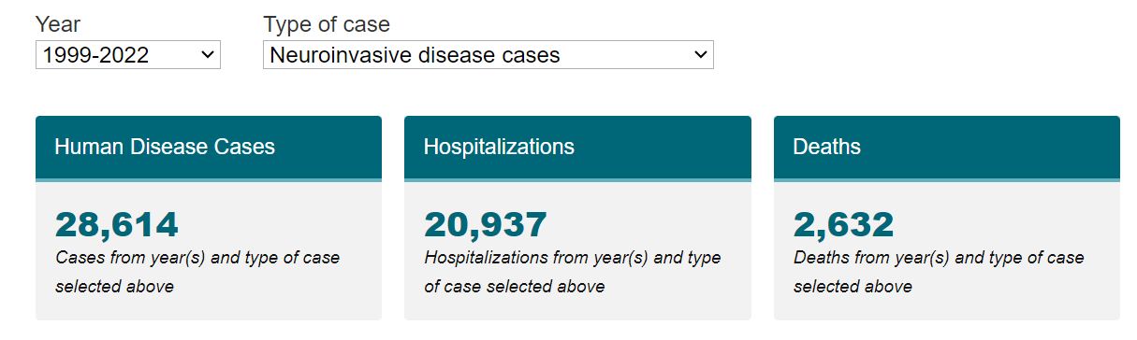
Neuroinvasive disease numbers
Source from CDC : https://www.cdc.gov/westnile/statsmaps/historic-data.html

Slide 42
Hyperparameters Tuning
 | Parameter 1 | Parameter 2 | Parameter 3 | Parameter 4
Logistic Regression | Penalty | Inverse of Regularization Strength | K-neighbour in SMOTE
Random Forest Classifier | Max Depth | N Estimator | K-neighbour in SMOTE
XGBoost Classifier | Max Depth | Learning Rate | N Estimator | K-neighbour in SMOTE
AdaBoost Classifier | N Estimator | Learning Rate | K-neighbour in SMOTE

Slide 43
Controlling Measures at a glance
 | Minimalist | Economist | Life-Saving
Protective Measures | Educational Campaign on Website | Machine Learning Campaign on Social Media | Mass Educational Campaign on Social Media
Early Detection | Sentinel Chicken | Dead Bird Surveillance | Mosquitoes Surveillance
Spread Control | Spray after first Human Case | Spray according to Machine Learning | Spray after Early Detection Method
Sources from National Library of Medicine : https://www.ncbi.nlm.nih.gov/pmc/articles/PMC3367363/

Slide 44
Controlling Measures at a glance
 | Minimalist | Economist | Life-Saving
Protective Measures | Educational Campaign on Website | Machine Learning Campaign on Social Media | Mass Educational Campaign on Social Media
Early Detection | - | Perform Model Prediction using Machine Learning | Sentinel Chicken + Mosquitoes Surveillance
Spread Control | Spray after first Human Case | Spray according to Machine Learning | Spray after Early Detection Method
More $$
Sources from National Library of Medicine : https://www.ncbi.nlm.nih.gov/pmc/articles/PMC3367363/

Slide 45
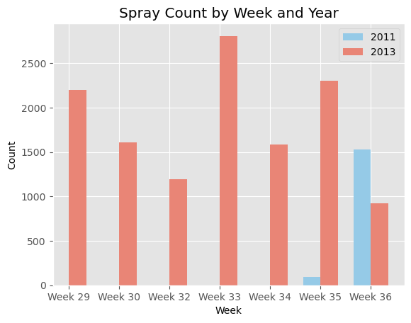
ARE THE SprayING EFFORTS EFFECTIVE?
The spr

Slide 46
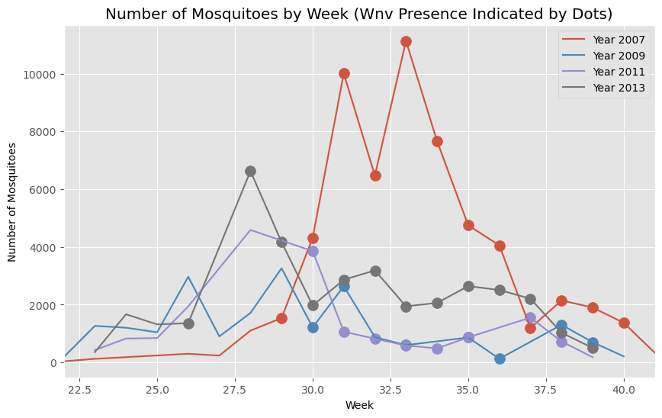
Is SPRAY effective?
Red bar is SPRAY

Slide 47
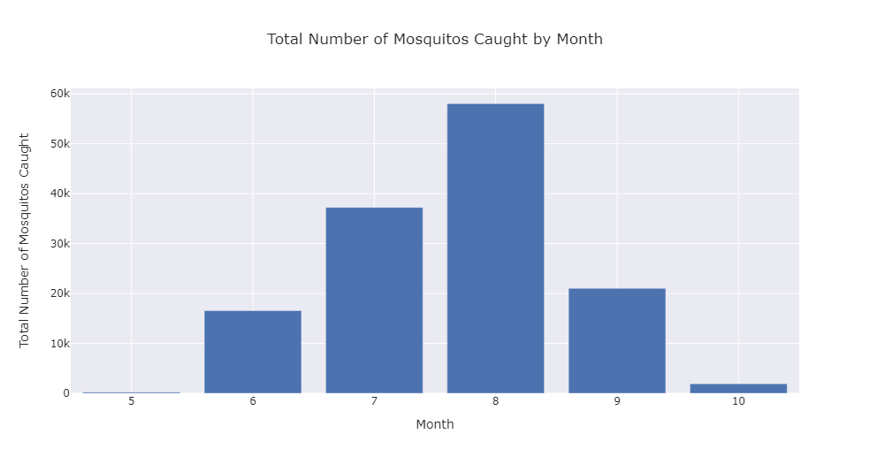
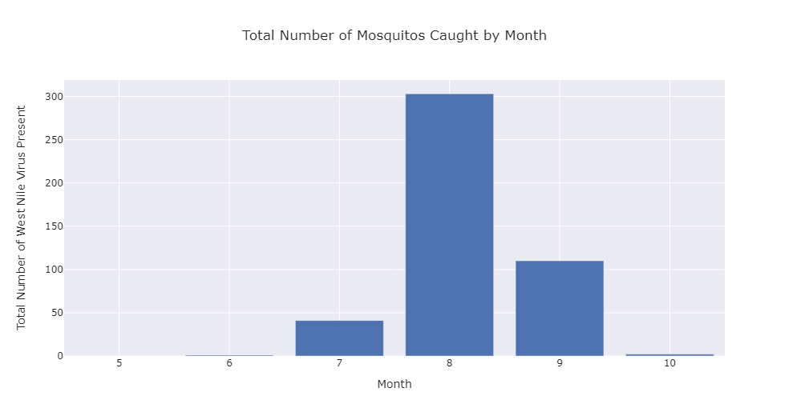
Insights
Insights
August has the
most mosquitoes caught and most WNV Present

Slide 48
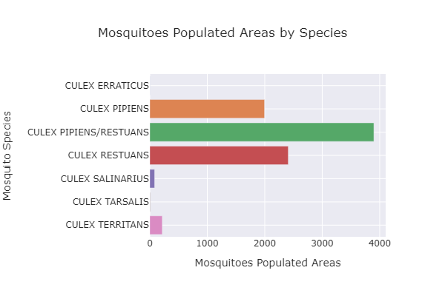
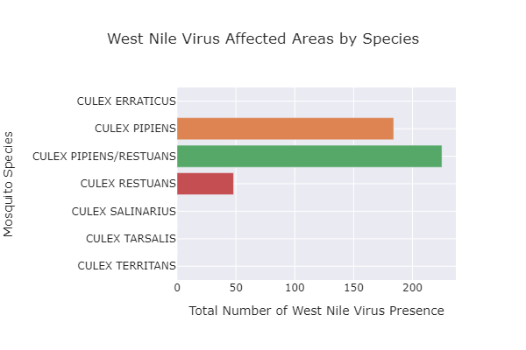
Insights
4 species of mosquitoes caught in chicago
ONLY 2 species of mosquitoes carries west nile virus

Slide 49
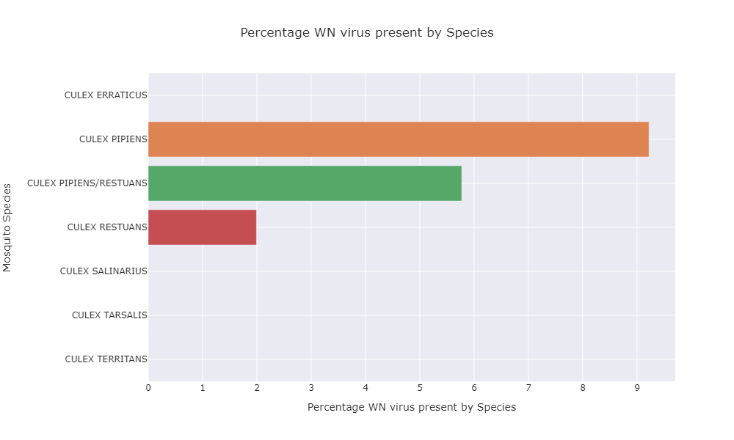
Derived Insights
Percentage WNV
= (WNV area/Mosquito area)* 100
Culex pipiens is
5x
More likely to carry wNV than culex Restuans

Slide 50
Number of Mosquitos caught weekly
Figures seems random
High numbers in 2007
There are no clear tends observed.
Year 2007 was observed to have higher number of mosquitos caught.

Slide 51
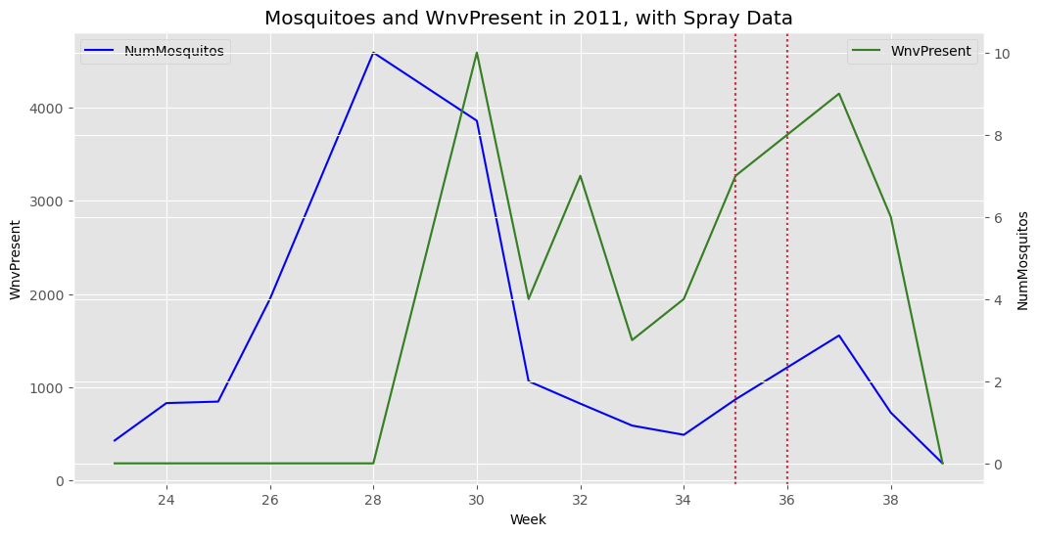
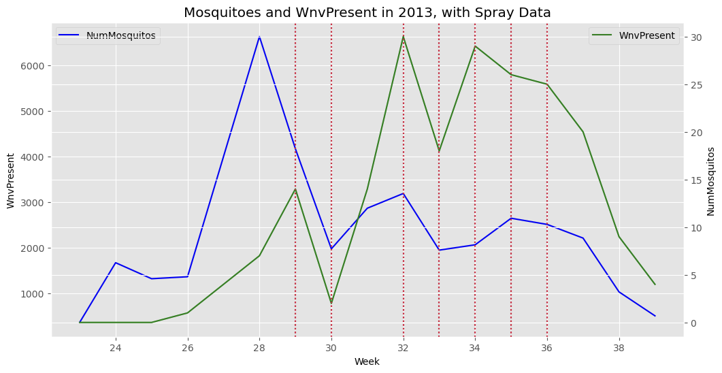
SPRAY

Slide 52
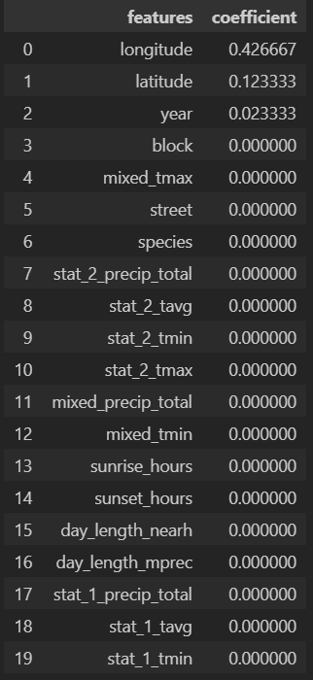
Feature importance list.
Placeholder
While we wait for shapley to be out. But it doesnt seem to be working.
If we are using this table →
There’s only 3 values……

Slide 53
Calculation

Slide 54
TABLE OF CONTENTS
01
02
03
About the Disease
DIAGNOSIS
RECOMMENDATIONS
05
04
06
PATHOLOGY
TREATMENT
CONCLUSIONS
You could describe the topic of the section here
You could describe the topic of the section here
You could describe the topic of the section here
You could describe the topic of the section here
You could describe the topic of the section here
You could describe the topic of the section here

Slide 55
INTRODUCTION
Mercury is the closest planet to the Sun and the smallest one in the Solar System—it’s only a bit larger than the Moon

